Slide 1
Employee Data Analysis using Excel
STUDENT NAME: TUSHAR Y
REGISTER NO: 122201200 ; unm1301222550
DEPARTMENT: B.COM CORPORATE SECRETARYSHIP
COLLEGE: AGURCHUND MANMULL JAIN COLLEGE

Slide 2
PROJECT TITLE
Employee Performance Analysis using Excel

Slide 3


AGENDA
Problem Statement
Project Overview
End Users
Our Solution and Proposition
Dataset Description
Modelling Approach
Results and Discussion
Conclusion
3/21/2024 Annual Review

Slide 4

PROBLEM STATEMENT
For the growth of an organisation, employee’s performance is crucial.
For better performance; promotion, increments and appreciation are received.
For lesser performance, employees are motivated to do in a better and effective manner.
To find out the better and lesser performers, it is required to do Employee Data Analysis on the performance of the employees.

Slide 5

PROJECT OVERVIEW
Analysing the performance of the employee by considering various factors like gender, rating, performance core, achievements is called Employee Data (Performance) Analysis. It is helpful in identifying the trends and patterns of different categories of employees like high, medium and low. Employee Performance Analysis helps in identifying weak performers and motivating them to become great performers by focusing on them.

Slide 6
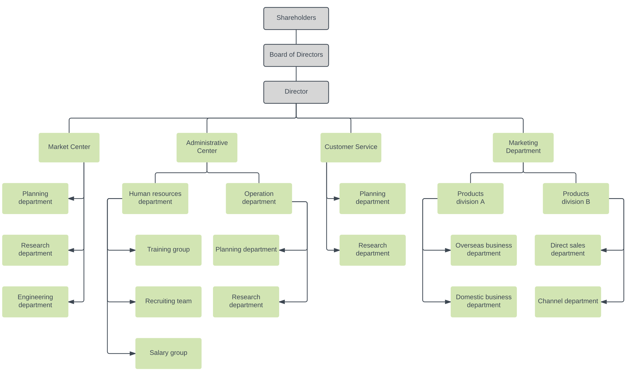

WHO ARE THE END USERS?
End users are those who get benefited from the employee data/performance analysis. Given below is a chart of end users of an organisation.

Slide 7

OUR SOLUTION AND ITS VALUE PROPOSITION
S.NO. | TECHNIQUES USED | EXPLANATION ( WHY )
1 | Conditional Formatting | To highlight the missing values
2 | Filtering | To remove the missing values
3 | Formula | To calculate Employee Performance Level
4 | Pivot Table | To summarise
5 | Graph | To present the data visually (Data Visualisation)

Slide 8
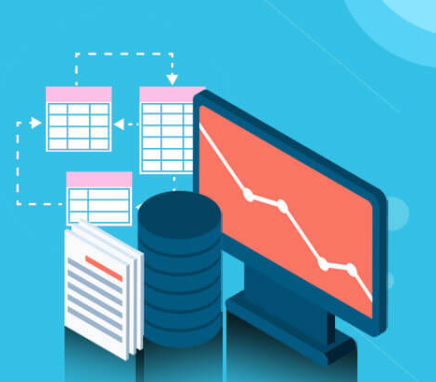
Dataset Description
Employee Data set – Kaggle
26 features:-
Only some of them have been considered:
Employee ID
Employee First Name
Employee Last Name
Employee Status
Employee Performance Level
Current Employee Ratings
Department Type
Division
Job Function

Slide 9

THE "WOW" IN OUR SOLUTION
New Ideas:-
Performance Level Formula = IFS(Z8>=5,”VERY HIGH”,Z8>=4,”HIGH”,Z8>=3,”MED”,”TRUE”,”LOW”)
3/21/2024 Annual Review
9

Slide 10
MODELLING
STEPS:-
1)Data Collection
Go to Kaggle and download
Download in Edunet Dashboard
2) Features Collection
9 Features
Employee ID
Employee First Name
Employee Last Name
Employee Status
Employee Performance Level
Current Employee Ratings
Department Type
Division
Job Function
3) Data Cleaning
Missing Values identified- Conditional Formatting
Missing Values removed – Filtering
4) Performance Level Calculation
Performance Level Formula = IFS(Z8>=5,”VERY HIGH”,Z8>=4,”HIGH”,Z8>=3,”MED”,”TRUE”,”LOW”)
10

Slide 11
MODELLING
S.NO. | TECHNIQUES USED | EXPLANATION (WHY)
1 | Conditional Formatting | Missing Value highlight
2 | Filtering | Missing Value Remove
3 | Formula | Calculate Employee Performance Level
4 | Pivot Table | Summarise
5 | Graph | Data Visualisation
5) Summary/Pivot Table
Features/Techniques Used
What Columns Used
Employee ID
Employee First Name
Employee Last Name
Employee Status
5. Employee Performance Level
6. Current Employee Ratings
7. Department Type
8. Division
9. Job Function

Slide 12
MODELLING
6) Graph
Data Visualisation
Features/Columns Used
Employee Performance Level
Current Employee Ratings
Department Type
Division
Job Function
Employee ID
Employee First Name
Employee Last Name
Employee Status

Slide 13
RESULTS
13

Slide 14
RESULTS

Slide 15
Conclusion
While comparing the performance of the employees, the number of employees are higher in number in average performing category. High level and very high level employees are very few in number. So, the management should motivate the average performing employees to perform better and be effective. They can motivate these employees by giving them different levels of tasks based on their performance and strength.
To conclude, medium performing employees are large in number. We need to motivate them for a better outcome. There are ups and downs in the performance of the employees. High Level performing employees in WBL Business Unit are more in number when compared to other departments.

